Slide 1
CHAPTER 3:
Direct Manipulation
Designing the User Interface:
Strategies for Effective Human-Computer Interaction
Fifth Edition
Ben Shneiderman & Catherine Plaisant
in collaboration with
Maxine S. Cohen and Steven M. Jacobs

Slide 2
Introduction
Good interfaces => Satisfied user
Competence in performing tasks
Ease in learning originally and in assimilating advanced features
Confidence in the capacity to retain mastery over time
Enjoyment in using the interface
Eagerness to show off the interface to novices
Desire to explore more powerful aspects
Direct-manipulation interfaces => Good interfaces
  Visible objects
  Rapid, reversible, incremental actions
  Pointing actions
6-<number>

Slide 3
Introduction
Newer concepts extend direct manipulation
Include
  Collaborative interfaces
  Touchable interfaces
  Virtual reality
  Augmented reality
  Teleoperation
6-<number>

Slide 4
Examples of Direct-Manipulation Systems
  Spatial Data Management System
  Video Games
  Computer Aided Design
6-<number>

Slide 5
Direct-Manipulation Systems :
Spatial data management
In geographic applications, it seems natural to give a spatial representation in the form of a map that provides a familiar model of reality.
Xeroc PARC’s Information Visualizer : Tools for three-dimensional animated explorations of buildings, cone-shaped file directories, organization charts, a perspective wall that puts f atured items up front and centered, and several two- and three-dimensional information layouts.
ArcGIS™ by ESRI™is a widely used geographic-information system (GIS) that offers rich, layered databases of map-related information
GoogleMaps™and the more powerful Google Earth™ combines geographic information from aerial photographs, satellite imagery, and other sources to create a database of graphical information that can easily be viewed and displayed.
6-<number>

Slide 6
Direct-Manipulation Systems :
Video Games
Most exciting, well-engineered, and commercially successful example of direct-manipulation systems → Video Games
Pong first video game
Nintendo Wii, Sony PlayStation, and Microsoft Xbox continue to evolve
  3D, stereo sound, multiplayer, wireless controllers
  Commands are physical actions whose results are immediately shown on screen
  No syntax to remember → no syntax error messages
  Games continuously display a score → feedback encourages mastery
6-<number>

Slide 7
Direct-Manipulation Systems
Game Examples:
  SimCity – good example of direct manipulation / urban planning
  Second Life – social virtual world
  Spore – evolving creatures
  Myst – puzzle; well received
  DOOM and Quake controversial
  World of Warcraft – massive multiplayer game
  Guitar Hero video game
6-<number>

Slide 8
Direct-Manipulation Systems :
Computer-aided design
Most computer-aided design (CAD) systems for automobiles, electronic circuitry, aircraft, or mechanical engineering use principles of direct manipulation.
Building and home architects now have at their disposal powerful tools, such as Autodesk Inventor with components to handle structural engineering, floor plans, interiors, landscaping, plumbing, electrical installation, and much more.
There are large manufacturing companies using AutoCAD® and similar systems, but there are also other specialized design programs for kitchen and bathroom layouts, landscaping plans, and other homeowner-type situations.
Related applications are for computer-aided manufacturing (CAM) and process control. Honeywell's Experion® Process Knowledge System provides the manager of an oil refinery, paper mill, or power-utility plant with a colored schematic view of the plant.
6-<number>

Slide 9
Principles of Direct Manipulation
Continuous representations of objects and actions of interest with meaningful visual metaphors.
  Novices learn, masters quick, intermittent users retain, can see actions further goals
Physical actions or presses of labeled buttons, instead of complex syntax.
  Easy to learn, fewer errors, users feel in control
Rapid, incremental, reversible actions whose effects on the objects are visible immediately.
6-<number>

Slide 10
3D Interfaces
“Pure” 3D interfaces have strong utility in some context,
  e.g., medical, product design, scientific visualization
Other situations, more constrained 2D interfaces may be preferable to simplify interactions
  e.g. 3D bar charts, air-traffic control, digital libraries
“Enhanced” interfaces, better than reality, can help reduce the limitations of the real-world,
  e.g., providing simultaneous views, flying, x-ray vision
Games are good example
  Avatars in multiplayer 3-D worlds
  First person games
6-<number>

Slide 11
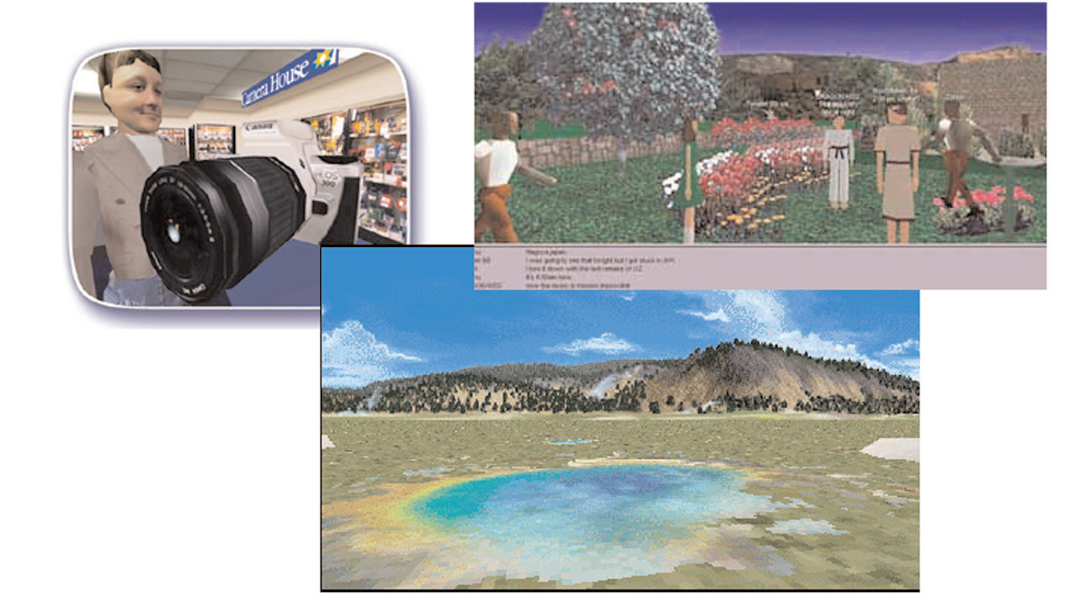
3D Interfaces
6-<number>

Slide 12
3D Interfaces
Some designers dream about building interfaces that approach the richness of three-dimensional reality.
Closer the interfaces to the real world, will be easier to use.
For some computer-based tasks—such as medical imagery, architectural drawing, computer-assisted design, chemical-structure modeling, and scientific simulations—pure 3D representations are clearly helpful and have become major industries.
Successful applications of 3D representations are game environments
Some web-based game environments, such as Second Life, may involve millions of users and thousands of user-constructed "worlds," such as schools, shopping malls, or urban neighborhoods.
Three-dimensional art and entertainment experiences, often delivered by web applications, provide another opportunity for innovative applications.
6-<number>

Slide 13
3D Interfaces
Features for effective 3D:
  Use occlusion, shadows, perspective, etc. carefully.
  Minimize number of navigation steps for users to accomplish their tasks.
  Keep text readable.
  Avoid unnecessary visual clutter, distraction, contrast shifts, and reflections.
  Simplify user movement.
  Prevent errors.
  Simplify object movement
  Organize groups of items in aligned structures to allow rapid visual search.
  Enable users to construct visual groups to support spatial recall.
6-<number>

Slide 14
Teleoperation
Derives from two concepts:
  direct manipulation in personal computers
  process control in complex environments
Physical operation is remote controlled
  Surgery, power plants, chemical plants, military ops, computer-supported collaborative work
Teleoperation (or remote operation) indicates operation of a system or machine at a distance.
6-<number>

Slide 15
Teleoperation - Applications
Telemedicine:
Medical care delivered over communication links
Allows physicians to examine patients remotely and surgeons to carry out operations across continents.
Telepathology
A pathologist examines tissue samples or body fluids under a remotely located microscope.
The transmitting workstation has a high resolution camera mounted on a motorized light microscope.
The pathologist at the receiving workstation can manipulate the microscope using a mouse or keyboard and can see a high resolution image of magnified sample.
6-<number>

Slide 16
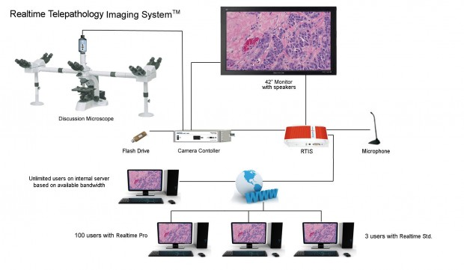

Telepathology
6-<number>

Slide 17
Teleoperation - Applications
Virtual Colonoscopy:
Allows the patient to undergo a CT scan as opposed to a more invasive procedure;
The physicians can then interactively navigate through a 3D model .
Robotic surgery
An alternative to conventional surgery that enables a smaller incision and more accurate and precise surgical movements.
6-<number>

Slide 18
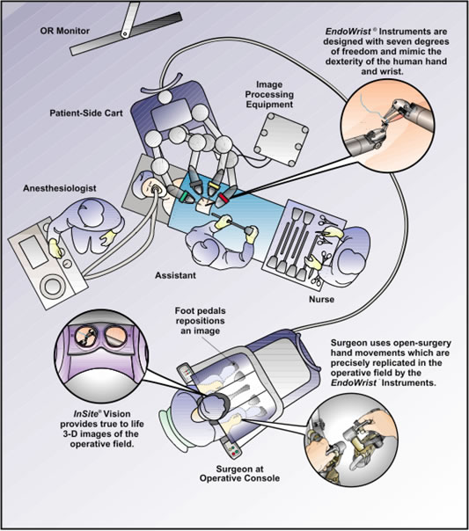
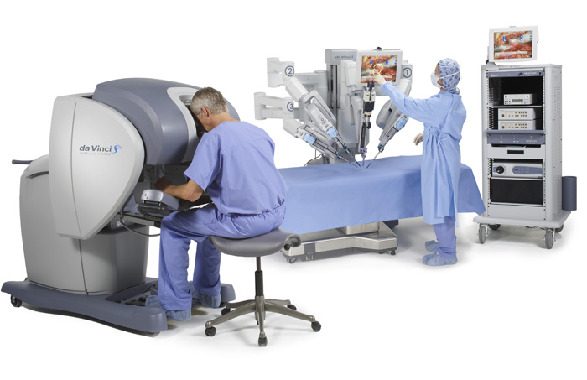
Robotic surgery
6-<number>

Slide 19
Teleoperation – military application
Commonly used by the military and by civilian space projects
Operations using unmanned aircraft
Teleoperated missile firing aircraft
Agile and flexible mobile robot
Harsh environments such as undersea, space exploration
6-<number>

Slide 20
Teleoperation
Complicating factors in the architecture of remote environments:
  Time delays
    transmission delays
    operation delays
  Incomplete feedback
  Feedback from multiple sources
  Unanticipated interferences
6-<number>

Slide 21
Direct Manipulation – Benefits and Drawbacks
Benefits:
Control/display compatibility
Less syntax reduces error rates
Errors are more preventable
Faster Learning and higher retention
Encourages exploration
Drawbacks:
Increased system resources
Some action may be cumbersome
Macro techniques are often weak
History and other tracing may be difficult
Visually impaired users may have more difficulty
6-<number>

